Slide 1
Walmart Sales Forecasting
By: Hasib Chowdhury (500439135)

Slide 2
About Project
For this project, I have decided to use the Walmart Sales Forecasting on the Kaggle Website to determine the sales forecasting using regression and random forest to compare 2 models of the best and worst stores in term of weekly sales
Notes:
Background: Walmart is a renowned retail corporation that operates a chain of hypermarkets. Here, Walmart has provided a data combining of 45 stores including store information and weekly sales from its various departments. The data is provided on weekly basis from February 2010 to October 2012 (2.5 year time span). Walmart tries to find the impact of holidays on the sales of store. For which it has included four holidays’ weeks into the dataset which are Christmas, Thanksgiving, Super bowl, Labor Day. We are going to analyze the data in more depth using techniques such as regression and random forest. In the dataset, several variables are given as features, so we need to analyze if sales are impacted by specific holidays.

Slide 3
The dataset
This dataset has 420,213 rows with 23 columns (attributes). In total, there are 45 different Walmart stores with about 100 departments in each of 3 different types (A,B,C) and different sizes which will be analyzed throughout the project.
The data is provided on a weekly basis from February 2010 to October 2012, over a 2.5-year period, and each week has its own set of features such as different CPI (consumer price index), unemployment rate as well as whether a holiday was a factor in its performance.

Slide 4
Research Questions
How the model fits under stepwise regression to build a model using weekly sales as the target variable and all the other variables as separate independent variables
Comparing between the 2 best and worst stores out of the 45 in total, in terms of performance of the weekly sales (in all departments) using random forest for regression.
Whether the holiday seasons are a factor in terms of sales for this dataset (Christmas, Thanksgiving, Labor Day etc. )

Slide 5
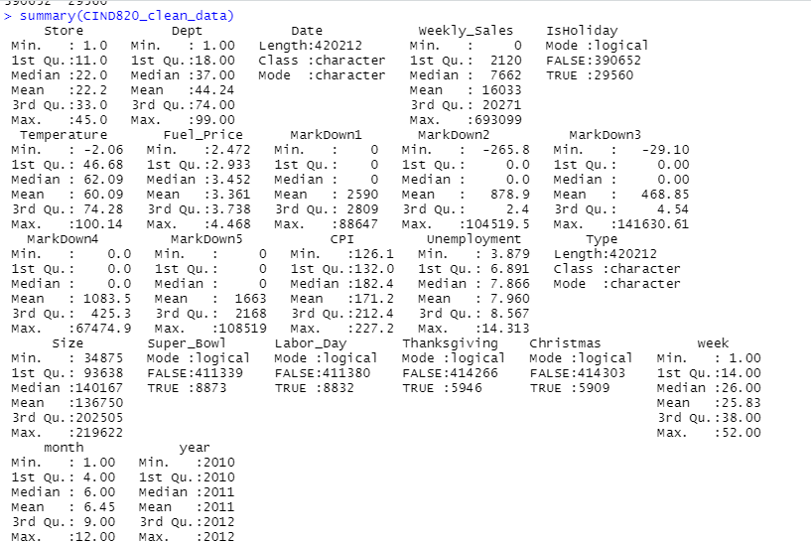
Notes:
This slide represents the summary taking into account all 420,000 rows of the data in the original dataset, for making the model, the weekly sales was used as a target variable and all the other variables such as Temperature, Fuel_Price, CPI , Unemployment , Size , the 5 different markdowns was used as the independent variable to get a stepwise regression model as well as a random forest. The holidays such as Christmas, Superbowl, Labor Day, Thanksgiving were not taken into account as they were represented as TRUE/FALSE and didn’t fit in the data as these were categorical values.

Slide 6
Data Description
There are a total of 23 columns in this dataset. The attributes in the Walmart sales forecast are as follows: Store, Department, Date, Weekly Sales, IsHoliday, Temperature, Fuel Price, Markdowns 1-5, CPI, Unemployment, Type, Size, Holidays (such as SuperBowl, Christmas, Labor Day, Thanksgiving), along with the month, week , and the year.
9 of the variables were categorical (including the dates and time of year) and the rest were numerical
The target variable in the dataset is the weekly sales which we are trying to predict in terms of other independent variables such as CPI, Temperature, Fuel Price, etc.
Notes:
In total, 81 departments for most of the stores were considered because some departments were missing in the dataset as they ranged anywhere between 1-98 for each store.

Slide 7
Literature Review
The literature review for the Walmart sales forecasting dataset will consist of regression and k-fold cross validation for sales forecasting to predict the outcomes for Walmart in the near future in terms of its weekly sales, it will also focus on random forest for time series. There are several seasons that affect sales in a given time of year that are significantly more or less than averages depending on a variety of factors. In this scenario, if Walmart is unaware about the seasons (eg Spring, Summer, Fall, Winter), it can lose too much money which in effect can cause low profit for the company. Predicting future sales is one of the most crucial plans for a big company such as Walmart since sales forecasting gives us an idea to the company for arranging stocks, calculating revenue, and deciding to make a new investment.

Slide 8
Literature Review
“Forecasts have traditionally served as the basis for planning and executing supply chain activities. Forecasts drive supply chain decisions, and they have become critically important due to increasing customer expectations, shortening lead times, and the need to manage scarce resource” (Boone, T. et. al, p. 170)
“Firms use product sales forecasting as a foundation to estimate sales revenue and make decisions regarding production, operation and marketing strategies” (Fan, Z. et. al, p. 90)
“Through product sales forecasting, firms can create a plan for marketing, sales management, production, procurement, logistics and so on to improve their economic benefits and reduce losses caused by weaknesses in the production plan” (Fan, Z. et al, p. 90).

Slide 9
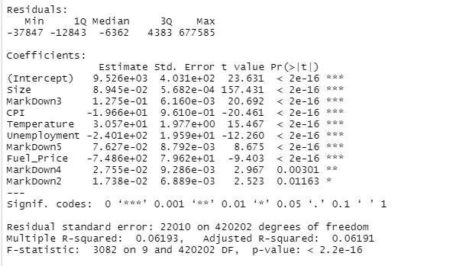
Modelling Using Stepwise Regression (Forward Selection)
Notes:
The forward selection approach (screenshot of the output) starts with no variables and adds each new independent variable one by one depending on the values of the AIC (goes from large values to small values depending on the model’s input variables) testing for statistical significance.
The equation we get from the output becomes:
Weekly_Sales = 0.08945*Size + 0.1275*MarkDown3 - 19.66*CPI + 30.57*Temperature -240.1*Unemployment + 0.07627*MarkDown5 - 748.6*Fuel_Price + 0.02755*MarkDown4 + 0.01738*MarkDown2 + 9526

Slide 10
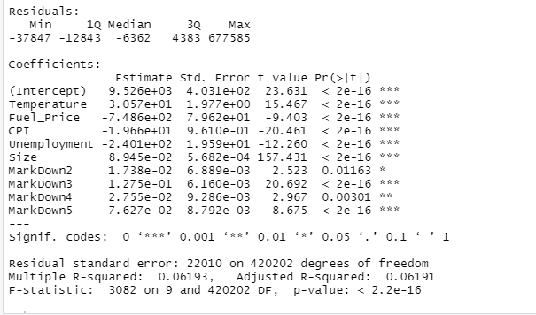
Modelling Using Stepwise Regression (Backward Elimination)
Notes:
The backward elimination method begins with a full model loaded with multiple independent variables and then removes one independent variable at a time to test its statistical significance to overall results depending on the value of the AIC (goes from small to large, opposite to the forward selection).
The equation we get from the output becomes:
Weekly_Sales = 30.57*Temperature - 748.6* Fuel_Price - 19.66*CPI -240.1*Unemployment 0.08945*Size + 0.01738*MarkDown2 + 0.1275*MarkDown3 + 0.02755*MarkDown4 + 0.07627*MarkDown5 + 9526
Markdown1 is redundant (not considered in the model) and markdowns 2-5 are more relevant and observed in the intercept as well as the whole dataset. Size is the most important variable due to the values and might have more departments in specific locations to attract more clients and also the products/services that location may have.

Slide 11
Stepwise regression equations for 2 methods
The forward selection equation:
Weekly_Sales = 0.08945*Size + 0.1275*MarkDown3 - 19.66*CPI + 30.57*Temperature -240.1*Unemployment + 0.07627*MarkDown5 - 748.6*Fuel_Price + 0.02755*MarkDown4 + 0.01738*MarkDown2 + 9526
The backward elimination equation:
Weekly_Sales = 30.57*Temperature - 748.6* Fuel_Price - 19.66*CPI -240.1*Unemployment 0.08945*Size + 0.01738*MarkDown2 + 0.1275*MarkDown3 + 0.02755*MarkDown4 + 0.07627*MarkDown5 + 9526

Slide 12
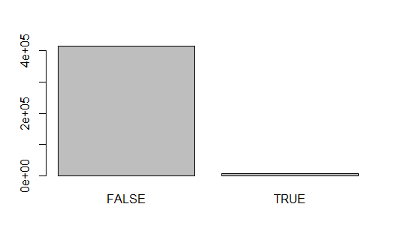
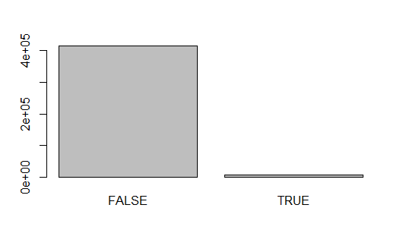
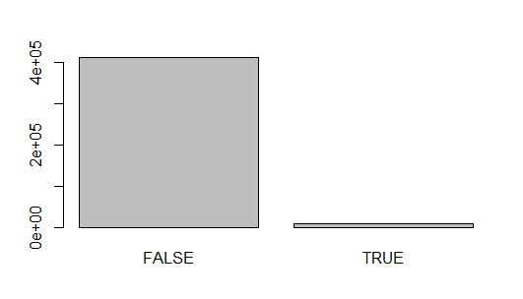
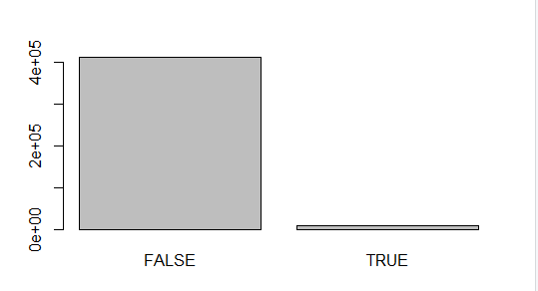
Barplots for the weekly sales and holidays

Slide 13
Best and worst stores in terms of weekly sales
The following code tells us the best and worst stores (out of the 45 total) in terms of it’s performance on the weekly sales.
store_sales <- aggregate(train_set$Weekly_Sales, list(train_set$Store),sum)
names(store_sales)<-c("store","Total_Sales")
str(store_sales) # gives us 45 different stores of the total sales, combining all the departments
min(store_sales$Total_Sales) # 0.8388226
max(store_sales$Total_Sales) # 7.677282
which(store_sales$Total_Sales==min(store_sales$Total_Sales))
#Store 44 has the lowest total weekly sales out of the 45 stores at 0.8388226
which(store_sales$Total_Sales==max(store_sales$Total_Sales))
#Store 20 has the highest total weekly sales out of the 45 stores at 7.677282
Notes:
The above code tells us that store 44 has the lowest total weekly sales (in all the departments) at 0.8388 and store 20 has the highest total weekly sales at approximately 7.68 (this data came from the normalization data values).
We first had to remove the ‘NA’ values from both the datasets as an error kept appearing. Store 20 had a total of 10,173 total rows taken into account when considering this model from its 81 different departments (listed from 1 to 98 but some department numbers like 61-66 are missing) from February 2010 to October 2012, whereas Store 44 also has 81 departments from February 2010 to October 2012 however 7,142 total rows were considered (this may have thrown off the results).

Slide 14
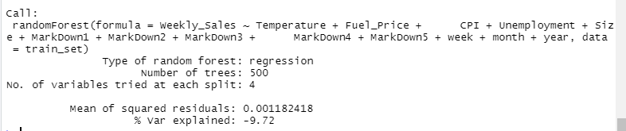
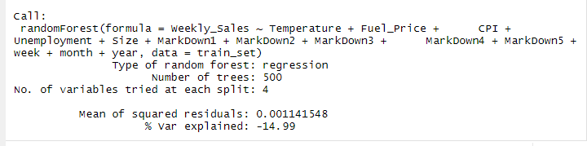
Random forest for regression
Notes:
The value of the mean of squared residuals is 0.001182418, which tells us the data is consistent with all the other variables (for 7000 training set and 3000 testing set). However when the training data changes to 8000 for training set and 2000 for testing set, the mean of squared residuals changes to 0.00114, this is due to the fact that more data values are being taken into account.

Slide 15
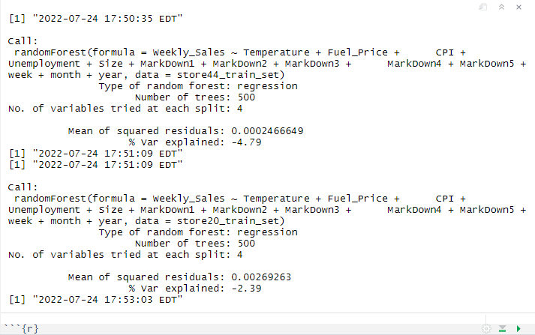
Random Forest for the best and worst stores
Notes:
The 2 stores with the highest and lowest total weekly sales were store 44 (lowest weekly sales) and store 20 (highest weekly sales). This was the output of the random forest model for the 2 stores training set.
Store 20 had a total of 10,173 total rows taken into account when considering this model from its 81 different departments from February 2010 to October 2012, whereas Store 44 also had 81 departments (some departments are missing from this dataset) from February 2010 to October 2012 however 7,142 total rows were considered. However when we broke this up into further when considering 70% training and 30% testing, this took into account 5,000 rows of the store 44 train set and 7,121 rows of the store 20 train set. The following is the output above.
As for results, they both gave very similar results as they both have regression as the type of random forest and both have the same number of tree as well as the # of variables at each split. However the % var explained is a bit lower in store 44 compared to store 20, and the mean of squared residuals is slightly higher in store 20 compared to store 44.

Slide 16
Holidays and how they affect the data
Not all holidays were considered in this dataset. The 4 main holidays considered were Super Bowl (mid-February), Labor Day (early September, before school year starts), Thanksgiving (late November) and Christmas holidays (last week of the year)
From the store 44 train set, there were a total of 348 rows that were holidays (68 being thanksgiving, 109 being Super Bowl, 67 being Christmas and 104 being labor day)
From the store 20 train set, there were a total of 499 rows that were holidays (98 being thanksgiving, 153 being Super Bowl, 96 being Christmas and 152 being labor day)
Notes:
Based on the numbers above when comparing the best and worst stores, its quite obvious that out of the 4 holidays, Walmart’s sales are usually higher around Super Bowl time when customers need to buy new TV’s or other electronics and during labor day, when people are going back to school in the fall compared to Christmas or thanksgiving. This was done by comparing 2 stores however, if the other 43 stores were taken into account, the results may have been different.

Slide 17
Effectiveness, Efficiency, and Stability
Train data | Test Data | Train RMSE | Test RMSE
1000 | 9000 | 0.1496976 | 0.151304
2000 | 8000 | 0.1516118 | 0.1512477
3000 | 7000 | 0.1539014 | 0.1513073
4000 | 6000 | 0.1515423 | 0.1513018
5000 | 5000 | 0.1503784 | 0.15128
6000 | 4000 | 0.1491193 | 0.1513039
7000 | 3000 | 0.1512367 | 0.1512731
8000 | 2000 | 0.1528445 | 0.1512889
9000 | 1000 | 0.151213 | 0.1512795
10000 | 0 | 0.1492315 | NaN
Notes:
When cross validation method was used for the entire dataset (over 420,000 rows), the training and testing split was split at 7000 rows for training and 3000 rows for testing.
This works out well compared to the other splits (e.g. 1000-9000, 2000-8000, etc) as the RMSE values are fairly even.
Also when comparing the 2 best and worst stores (stores 44 and 20), when using the Sys.time() command to compare the time it took to run the random forest regression model, it took about 45 seconds for store 44 train set (the worst store) for the model to run on R. As for store 20 (the best store), it took about 2 minutest for store 20 train set (the best store) for the model to run on R. Please note: this was done by trial and error as it depended on the computers memory.
- When the dataset was changed to 8000 rows for training, the data changed so that store 44 is no longer the worst store and a different store (store 33) was worse in terms of the weekly sales.

Slide 18
Conclusion
Both forward selection and backward elimination have the same intercept and R-squared value, however the forward selection is the better model of the 2
Store 20 has the highest weekly sales out of all the stores in its 81 different departments and store 44 has the lowest weekly sales out of all the stores, in terms of time required to generate the random forest model, store 20 train set (7121 rows) took about 2 minutes to generate, whereas the store 44 train set (5000 rows) took about 45 seconds.
Out of the 4 holidays listed on the dataset, Thanksgiving was the one with the most weekly sales when considering all stores

Slide 19
Further Research & Suggestions for improvement
This data does have flaws as it only covers a 2.5 year time span from Feb 2010 to Oct 2012, more data with less stores & departments with an extended period of time beyond 2012 would have been more convenient
Other factors such as Temperature, Fuel Price, or the CPI might have been considered when taking into account the weekly sales forecast.
Store 20 and 44 were considered the best and worst stores for weekly sales when taking into account, 7000 rows for training and 3000 rows for testing, this was done through trial and error and different stores may have been considered if the values were changed.

Slide 20
References
(https://www.kaggle.com/code/aslanahmedov/walmart-sales-forecasting/data ← where the dataset was obtained
Proactiveinvestors. (2021). Proactive Investors: Walmart sales beat forecasts but profits drop by a third. Newstex.
Boone, T., Ganeshan, R., Jain, A., & Sanders, N. R. (01/2019). Forecasting sales in the supply chain: Consumer analytics in the big data era Elsevier. doi:10.1016/j.ijforecast.2018.09.003
Fan, Z., Che, Y., & Chen, Z. (05/2017). Product sales forecasting using online reviews and historical sales data: A method combining the bass model and sentiment analysis Elsevier. doi:10.1016/j.jbusres.2017.01.010
Mentzer, J. T., & Cox, J. E. (01/1984). Familiarity, application, and performance of sales forecasting techniques Elsevier. doi:10.1002/for.3980030104
de Rezende, R., Egert, K., Marin, I., & Thompson, G. (12/2021). A white-boxed ISSM approach to estimate uncertainty distributions of walmart sales Elsevier. doi:10.1016/j.ijforecast.2021.11.006
K-Fold Cross Validation in R (Step-by-Step). Statology (November 4, 2020). Retrieved June 27, 2022 from https://www.statology.org/k-fold-cross-validation-in-r/ .
Machine Learning for Time Series Data in R. Decision Science Analytics. (May 12, 2020). Retrieved July 4, 2022 from https://www.pluralsight.com/guides/machine-learning-for-time-series-data-in-r

